Slide 1
Covid-19’s Impact on the Economy
Fatma Ünal
16030411051
MIS376

Slide 2
Impact of COVID-19
COVID-19, which first appeared in China and spread all over the world with its rapid spread, firstly affected life and therefore the economy at a great speed.
As the epidemic progressed, most jobs that required physical contact between people had to be suspended or carried out remotely.
For example, factories have stopped almost all kinds of economic activities, and the global supply chain has been disrupted.

Slide 3
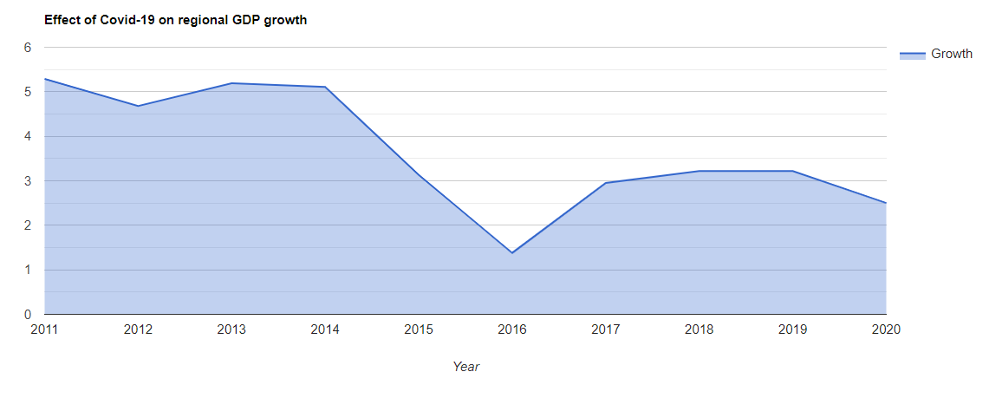
The cessation of factories and most other activities affected the whole world and was reflected in the GDP ratio.

Slide 4
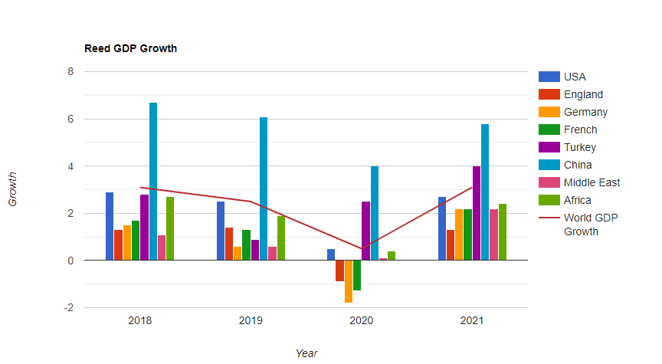
GDP change by country.

Slide 5
The world economy had to reduce its growth rate after the virus emerged. First of all, production in the world has decreased and has become limited.
This virus that started in China is here; food, toys, automotive industry, tourism, cinema, technology, smart devices industry, chip production, aviation, cinema, shopping and many other products and services have been restricted and therefore the economy has been deeply affected.
Since these production networks are interconnected, they have affected not only a single country but the whole world.

Slide 6
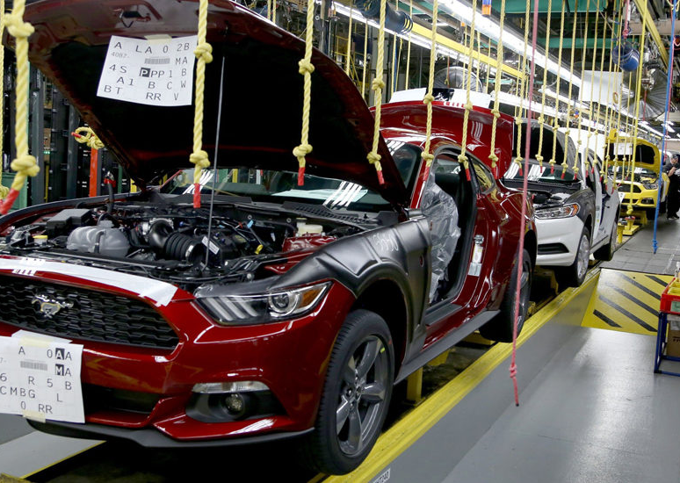
For example, although the automobile factory in Mexico manufactures and assembles automobiles, many parts are procured from manufacturers in China.
Since China is the production point of many things, this virus has greatly affected the economy. The world growth rate has had to progress by declining.

Slide 7
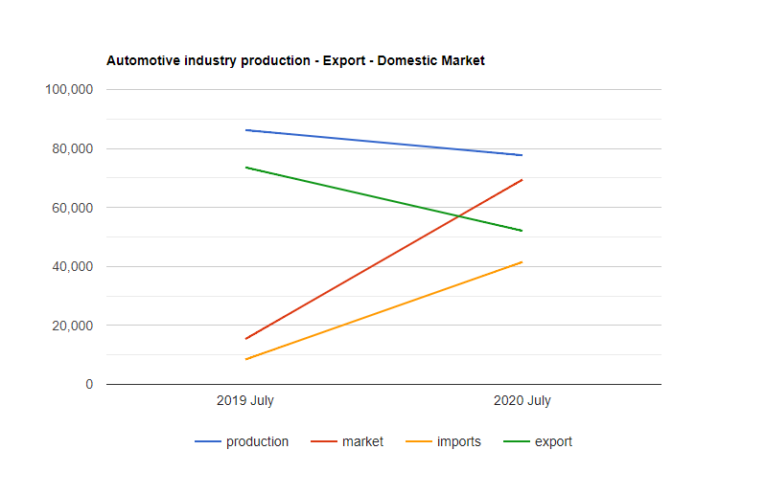
Impact on the automotive industry.

Slide 8
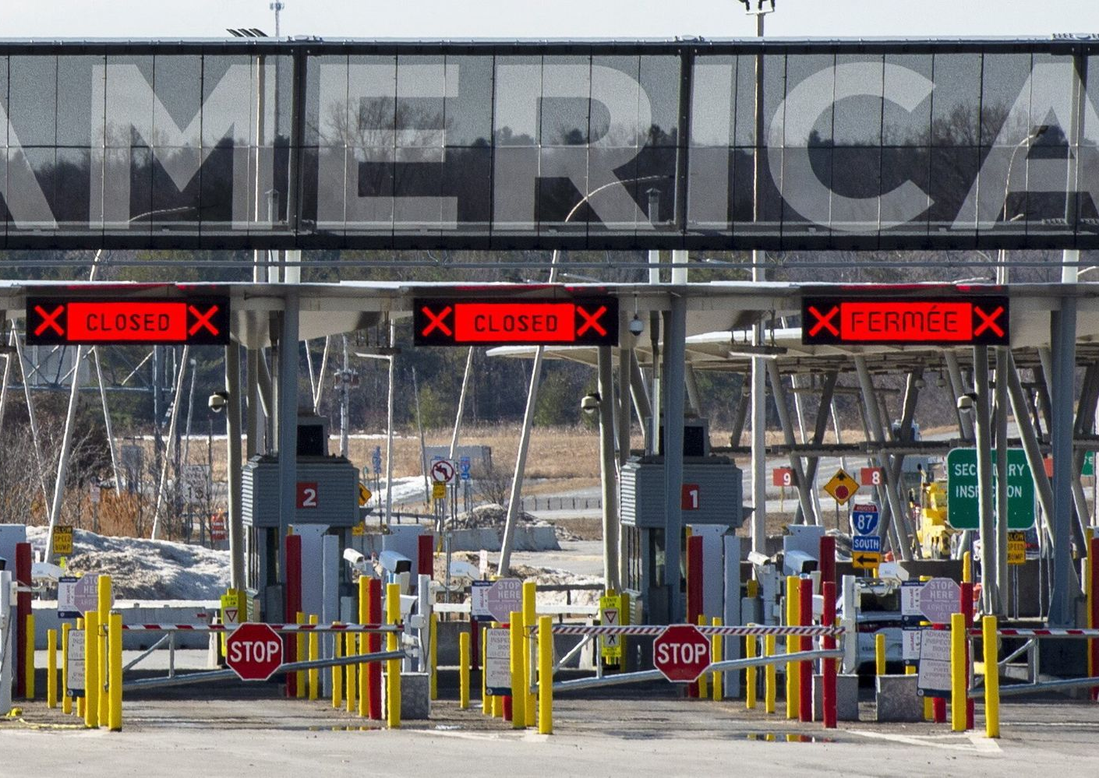
In addition, due to this epidemic, countries closed their border gates for certain periods and imports and exports could not be made at the point of foreign trade. Both producers and consumers were greatly affected by this situation and had bad effects on the economy.

Slide 9
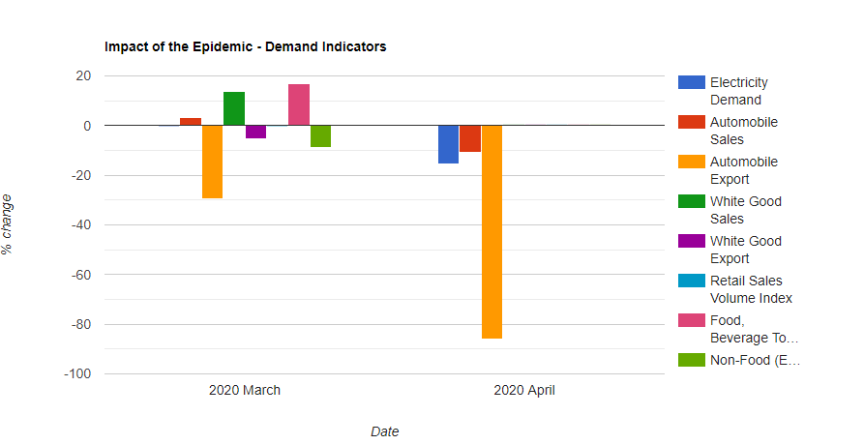
The change in these products after the pandemic.

Slide 10
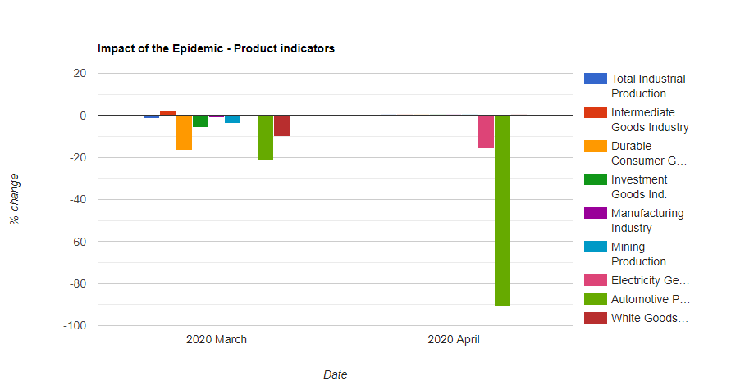
The change in these products after the pandemic.

Slide 11
COVID-19 has negatively affected production, employment, personal and business income, exports, current account deficit, and budget deficit in the Turkish economy, causing a recession.

Slide 12
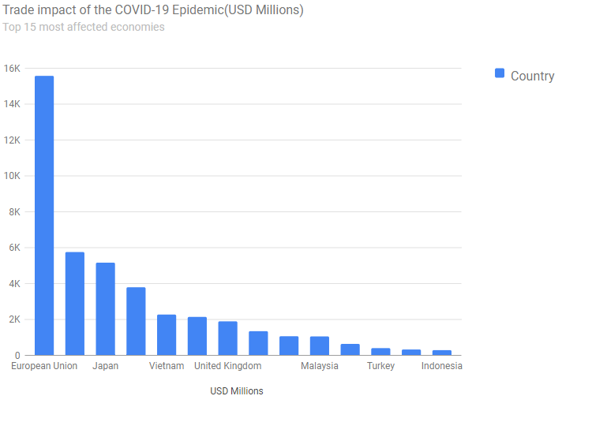
The commercial impact of the covid-19 epidemic in some countries.

